Slide 1
Graph Theory Shortest Paths II Bellman-Ford algorithm
Design and Analysis of Algorithms

Slide 2






Negative-weight cycles
Recall: If a graph G = (V, E) contains a negative- weight cycle, then some shortest paths may not exist.
Example:
…
< 0
u
v
Copyright © 2001-5 by Erik D. Demaine and Charles E. Leiserson
L18.2

Slide 3
Negative-weight cycles
Recall: If a graph G = (V, E) contains a negative- weight cycle, then some shortest paths may not exist.
Example:
…
< 0
u v
Bellman-Ford algorithm: Finds all shortest-path lengths from a source s ∈ V to all v ∈ V or determines that a negative-weight cycle exists.
Copyright © 2001-5 by Erik D. Demaine and Charles E. Leiserson
L18.3

Slide 4
Bellman-Ford algorithm
d[s] ← 0
for each v ∈ V – {s}
do d[v] ← ∞
initialization
for i ← 1 to |V| – 1
do for each edge (u, v) ∈ E
do if d[v] > d[u] + w(u, v)
then d[v] ← d[u] + w(u, v)
for each edge (u, v) ∈ E
relaxation step
do if d[v] > d[u] + w(u, v)
then report that a negative-weight cycle exists
At the end, d[v] = δ(s, v), if no negative-weight cycles. Time = O(VE).
Copyright © 2001-5 by Erik D. Demaine and Charles E. Leiserson
L18.4

Slide 5










Example of Bellman-Ford
B
2
–1
A
3
2
E
1
4
–3
C
D
5
Copyright © 2001-5 by Erik D. Demaine and Charles E. Leiserson
L18.5

Slide 6
Example of Bellman-Ford
B
2
–1
A
3
2
E
1
4
–3
C
D
5
Copyright © 2001-5 by Erik D. Demaine and Charles E. Leiserson
L18.5

Slide 7
Example of Bellman-Ford
∞
B
–1
2
0
∞
A
3
2
E
1
4
–3
C
∞
D
∞
5
Initialization.
Copyright © 2001-5 by Erik D. Demaine and Charles E. Leiserson
L18.6

Slide 8
Example of Bellman-Ford
∞
B
1
2
–1
0
∞
7
3
4
3
2
A
1
E
5
4
8
–3
2
C
∞
6
D
∞
5
Note: Red number with edges is showing order of edge relation
Copyright © 2001-5 by Erik D. Demaine and Charles E. Leiserson
L18.7

Slide 9
Example of Bellman-Ford
∞
B
1
2
–1
0
∞
7
3
4
3
2
A
1
E
5
4
8
–3
2
C
∞
6
D
∞
5
Copyright © 2001-5 by Erik D. Demaine and Charles E. Leiserson
L18.7

Slide 10
Example of Bellman-Ford
∞
B
1
2
–1
0
∞
7
3
4
3
2
A
1
E
5
4
8
–3
2
C
∞
6
D
∞
5
Copyright © 2001-5 by Erik D. Demaine and Charles E. Leiserson
L18.7

Slide 11
Example of Bellman-Ford
∞
B
1
2
–1
0
∞
7
3
4
3
2
A
1
E
5
4
8
–3
2
C
∞
6
D
∞
5
Copyright © 2001-5 by Erik D. Demaine and Charles E. Leiserson
L18.7

Slide 12
Example of Bellman-Ford
−1
B
1
2
–1
0
∞
7
3
4
3
2
A
1
E
5
4
8
–3
2
C
∞
6
D
∞
5
Copyright © 2001-5 by Erik D. Demaine and Charles E. Leiserson
L18.7

Slide 13
Example of Bellman-Ford
−1
B
1
2
–1
0
∞
7
3
4
3
2
A
1
E
5
4
8
–3
2
C
4
6
D
∞
5
Copyright © 2001-5 by Erik D. Demaine and Charles E. Leiserson
L18.7

Slide 14
Example of Bellman-Ford
−1
B
1
2
–1
0
∞
7
3
4
3
2
A
1
E
5
4
8
–3
2
C
4
6
D
∞
5
Copyright © 2001-5 by Erik D. Demaine and Charles E. Leiserson
L18.7

Slide 15
Example of Bellman-Ford
−1
B
1
2
–1
0
∞
7
3
4
3
2
A
1
E
5
4
8
–3
2
C
2
6
D
∞
5
Copyright © 2001-5 by Erik D. Demaine and Charles E. Leiserson
L18.7

Slide 16
Example of Bellman-Ford
−1
B
1
2
–1
0
∞
7
3
4
3
2
A
1
E
5
4
8
–3
2
C
2
6
D
∞
5
Copyright © 2001-5 by Erik D. Demaine and Charles E. Leiserson
L18.7

Slide 17
Example of Bellman-Ford
−1
B
1
2
–1
0
∞
7
3
4
3
2
A
1
E
5
4
8
–3
2
C
2
6
D
∞
5
End of Pass 1
Copyright © 2001-5 by Erik D. Demaine and Charles E. Leiserson
L18.7

Slide 18
Example of Bellman-Ford
−1
B
1
2
–1
0
∞
7
3
4
3
2
A
1
E
5
4
8
–3
2
C
2
6
D
∞
5
End of Pass 1
.
Copyright © 2001-5 by Erik D. Demaine and Charles E. Leiserson
L18.7

Slide 19
Example of Bellman-Ford-Pass2
−1
B
1
2
–1
0
1
7
3
4
3
2
A
1
E
5
4
8
–3
2
C
2
6
D
∞
5
Note: Red number with edges is showing order of edge relation
Copyright © 2001-5 by Erik D. Demaine and Charles E. Leiserson
L18.7

Slide 20
Example of Bellman-Ford
−1
B
1
2
–1
0
1
7
3
4
3
2
A
1
E
5
4
8
–3
2
C
2
6
D
∞
5
Copyright © 2001-5 by Erik D. Demaine and Charles E. Leiserson
L18.7

Slide 21
Example of Bellman-Ford
−1
B
1
2
–1
0
1
7
3
4
3
2
A
1
E
5
4
8
–3
2
C
2
6
D
1
5
Copyright © 2001-5 by Erik D. Demaine and Charles E. Leiserson
L18.7

Slide 22
Example of Bellman-Ford
−1
B
1
2
–1
0
1
7
3
4
3
2
A
1
E
5
4
8
–3
2
C
2
6
D
1
5
Copyright © 2001-5 by Erik D. Demaine and Charles E. Leiserson
L18.7

Slide 23
Example of Bellman-Ford
−1
B
1
2
–1
0
1
7
3
4
3
2
A
1
E
5
4
8
–3
2
C
2
6
D
1
5
Copyright © 2001-5 by Erik D. Demaine and Charles E. Leiserson
L18.7

Slide 24
Example of Bellman-Ford
−1
B
1
2
–1
0
1
7
3
4
3
2
A
1
E
5
4
8
–3
2
C
2
6
D
1
5
Copyright © 2001-5 by Erik D. Demaine and Charles E. Leiserson
L18.7

Slide 25
Example of Bellman-Ford
−1
B
1
2
–1
0
1
7
3
4
3
2
A
1
E
5
4
8
–3
2
C
2
6
D
1
5
Copyright © 2001-5 by Erik D. Demaine and Charles E. Leiserson
L18.7

Slide 26
Example of Bellman-Ford
−1
B
1
2
–1
0
1
7
3
4
3
2
A
1
E
5
4
8
–3
2
C
2
6
D
−2
5
Copyright © 2001-5 by Erik D. Demaine and Charles E. Leiserson
L18.7

Slide 27
Example of Bellman-Ford
−1
B
1
2
–1
0
1
7
3
4
3
2
A
1
E
5
4
8
–3
2
C
2
6
D
−2
5
Copyright © 2001-5 by Erik D. Demaine and Charles E. Leiserson
L18.7

Slide 28
Example of Bellman-Ford
−1
B
1
2
–1
0
1
7
3
4
3
2
A
1
E
5
4
8
–3
2
C
2
6
D
−2
5
End of pass 2 (and 3 and 4).
Copyright © 2001-5 by Erik D. Demaine and Charles E. Leiserson
L18.7

Slide 29
Shortest paths
Single-source shortest paths
Nonnegative edge weights
Dijkstra’s algorithm: O(E + V lg V)
General
Bellman-Ford algorithm: O(VE)
DAG
One pass of Bellman-Ford: O(V + E)
Copyright © 2001-5 by Erik D. Demaine and Charles E. Leiserson
L18.2

Slide 30
Shortest paths
Single-source shortest paths
Nonnegative edge weights
Dijkstra’s algorithm: O(E + V lg V)
General
Bellman-Ford algorithm: O(VE)
DAG
One pass of Bellman-Ford: O(V + E)
All-pairs shortest paths
Nonnegative edge weights
Dijkstra’s algorithm |V| times: O(VE + V ² lg V)
Copyright © 2001-5 by Erik D. Demaine and Charles E. Leiserson
L18.3

Slide 31
All-pairs shortest paths
Input: Digraph G = (V, E), where V = {1, 2,
…, n}, with edge-weight function w : E → R.
Output: n × n matrix of shortest-path lengths
δ(i, j) for all i, j ∈ V.
Copyright © 2001-5 by Erik D. Demaine and Charles E. Leiserson
L18.4

Slide 32
All-pairs shortest paths
Input: Digraph G = (V, E), where V = {1, 2,
…, n}, with edge-weight function w : E → R.
Output: n × n matrix of shortest-path lengths
δ(i, j) for all i, j ∈ V.
IDEA:
Run Bellman-Ford once from each vertex.
Time = O(V ²E).
Dense graph (Θ(n²) edges) ⇒ Θ(n ⁴) time in the worst case.
Good first try!
Copyright © 2001-5 by Erik D. Demaine and Charles E. Leiserson
L18.5

Slide 33
Reference
Introduction to Algorithms
Single Source Shortest Path
Chapter # 24
Thomas H. Cormen

Slide 34
All Pairs Shortest Path
given edge-weighted graph, G =(V, E,w)
find δ(u, v) for all u, v ∈ V

Slide 35
All-pairs shortest paths
Negative Edge Weight:
Input: Digraph G = (V, E), where V = {1, 2,
…, n}, with edge-weight function w : E → R.
Output: n × n matrix of shortest-path lengths
δ(i, j) for all i, j ∈ V.
IDEA:
Run Bellman-Ford once from each vertex.
Time = O(V ²E).
Dense graph (Θ(n²) edges) ⇒ Θ(n ⁴) time in the worst case.
Good first try!

Slide 36
Recap (Dynamic Programming)
1. Characterize the structure of an optimal solution.
2. Recursively define the value of an optimal solution.
3. Compute the value of an optimal solution in a bottom-up fashion.

Slide 37
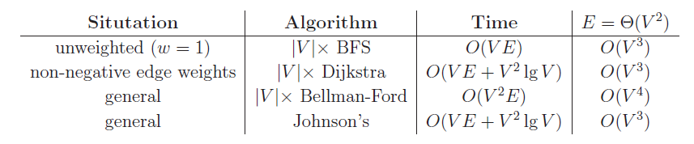
All-pairs shortest paths

Slide 38
Better Approach!!!
Dynamic Programming

Slide 39
FlOYD-WARSHALL

Slide 40
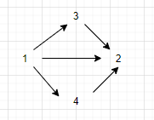
Shortest path from “1” to “2”
It can be direct.
It can be via 3.
It can be via 4.

Slide 41
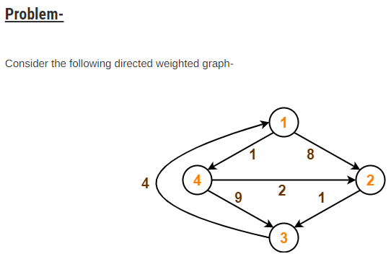
Floyd-Warshall

Slide 42
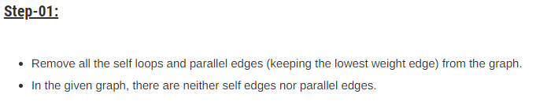
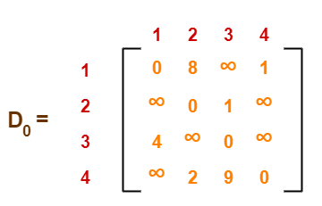
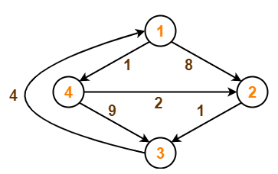

Slide 43
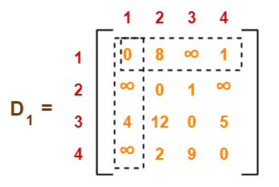
D₁[2,3] = min( D₀[2,3] , D₀[2,1]+D₀[1,3] )
Here k=1

Slide 44
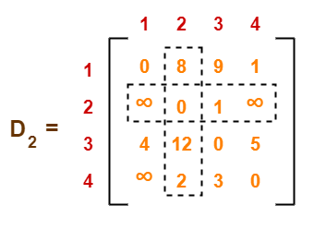

Slide 45
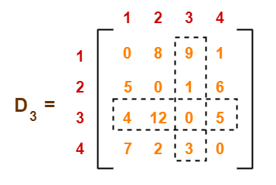

Slide 46
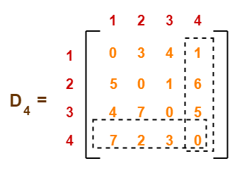

Slide 47
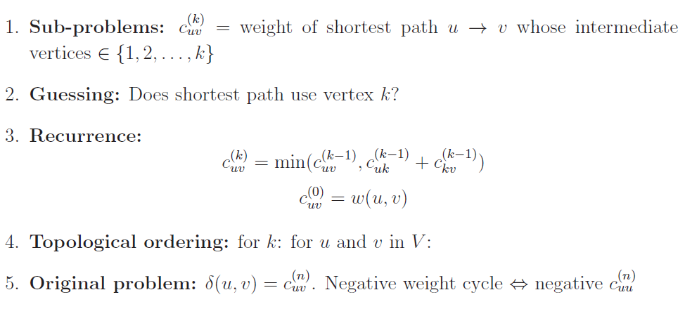
Floyd-Warshall:

Slide 48
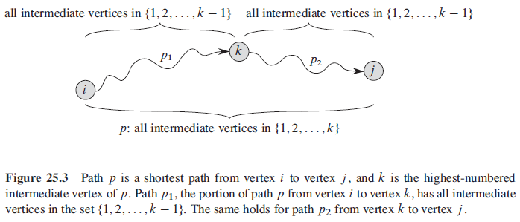

Slide 49
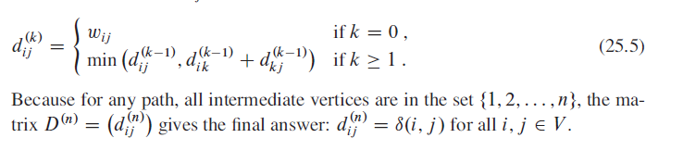
A recursive solution to the all-pairs shortest-paths problem

Slide 50
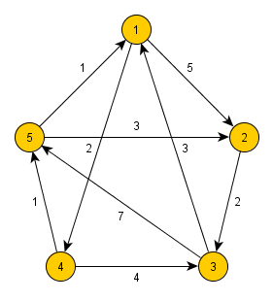
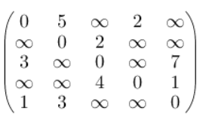
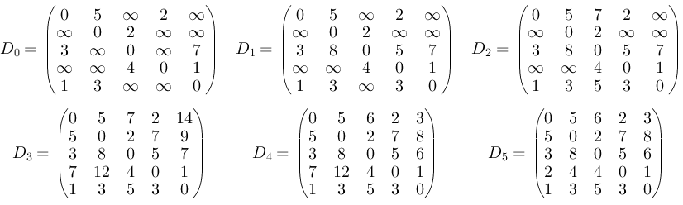
`

Slide 51
Floyd-Warshall:
In each iteration of Floyd-Warshall algorithm is this matrix recalculated, so it contains lengths of paths among all pairs of nodes using gradually enlarging set of intermediate nodes.
The matrix D₁, which is created by the first iteration of the procedure, contains paths among all nodes using exactly one (predefined) intermediate node.
D₂ contains lengths using two predefined intermediate nodes.
Finally the matrix D_{n} uses n intermediate nodes.

Slide 52
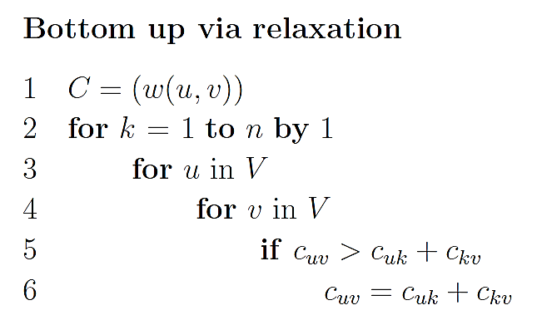
Floyd-Warshall:
This Dynamic Program contains O(V³) problems
O(1) time to solve each sub-problem
total runtime is O(V³).
O(V³)
Simple to code.
Efficient in practice.

Slide 53
Reference
Introduction to Algorithms
All Pairs Shortest Path
Chapter # 25
Thomas H. Cormen

